Slide 1
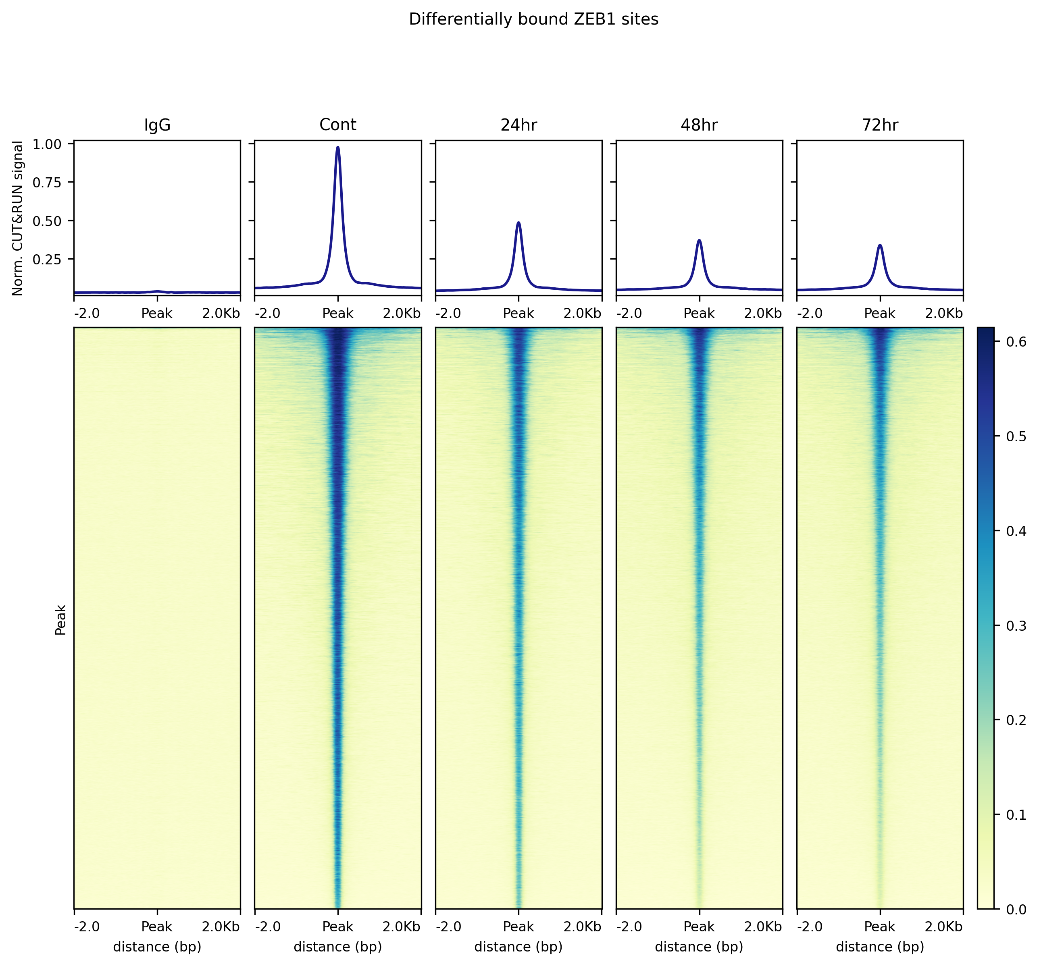
ZEB1 CUT&RUN – MDA, hg38 – Consensus peaks
Consensus peak set (n = 52,981) generated by merging individual peak sets for each sample group (control, 24/48/72-tx)

Slide 2
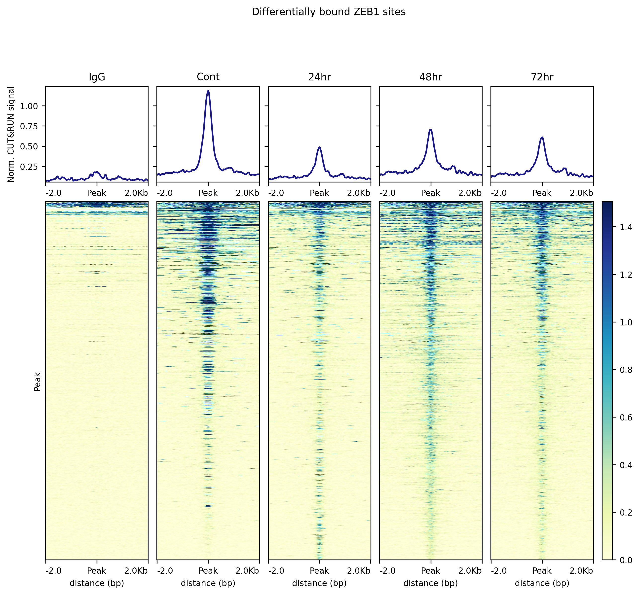
ZEB1 CUT&RUN – MDA, hg38 – Differentially bound peaks
Differentially bound peak set (n = 1398) generated by merging all statistically significant differential peaks from analysis of control vs each tx-condition (24/48/72hr)

Slide 3
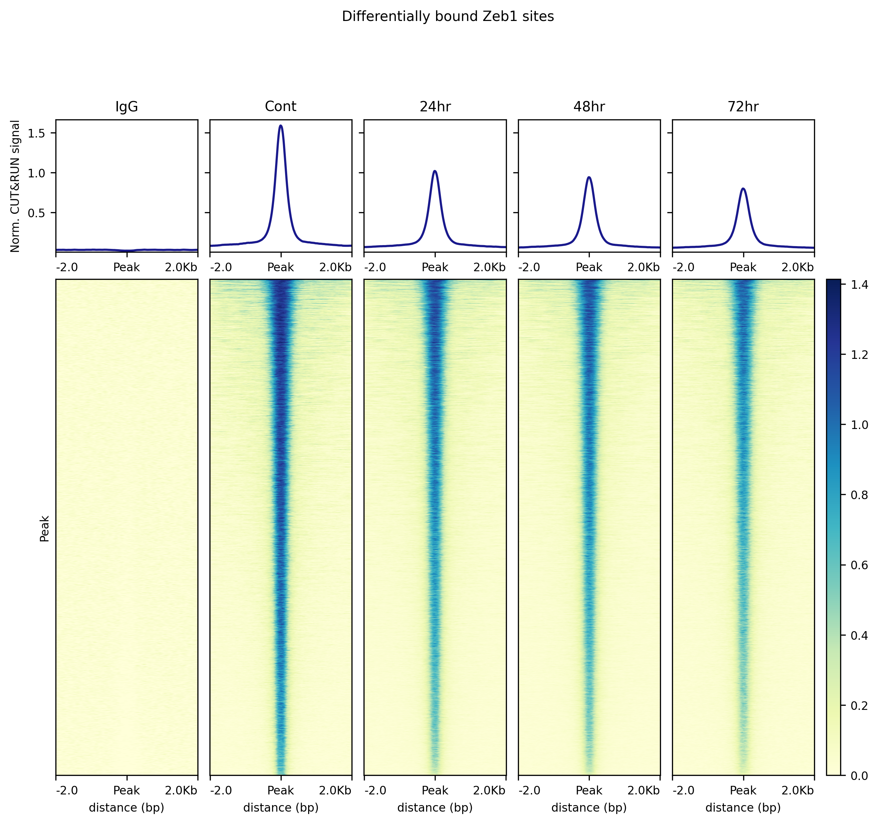
Zeb1 CUT&RUN – PB3, mm10 – Consensus peaks
Consensus peak set (n = 23,623) generated by merging individual peak sets for each sample group (control, 24/48/72-tx)

Slide 4
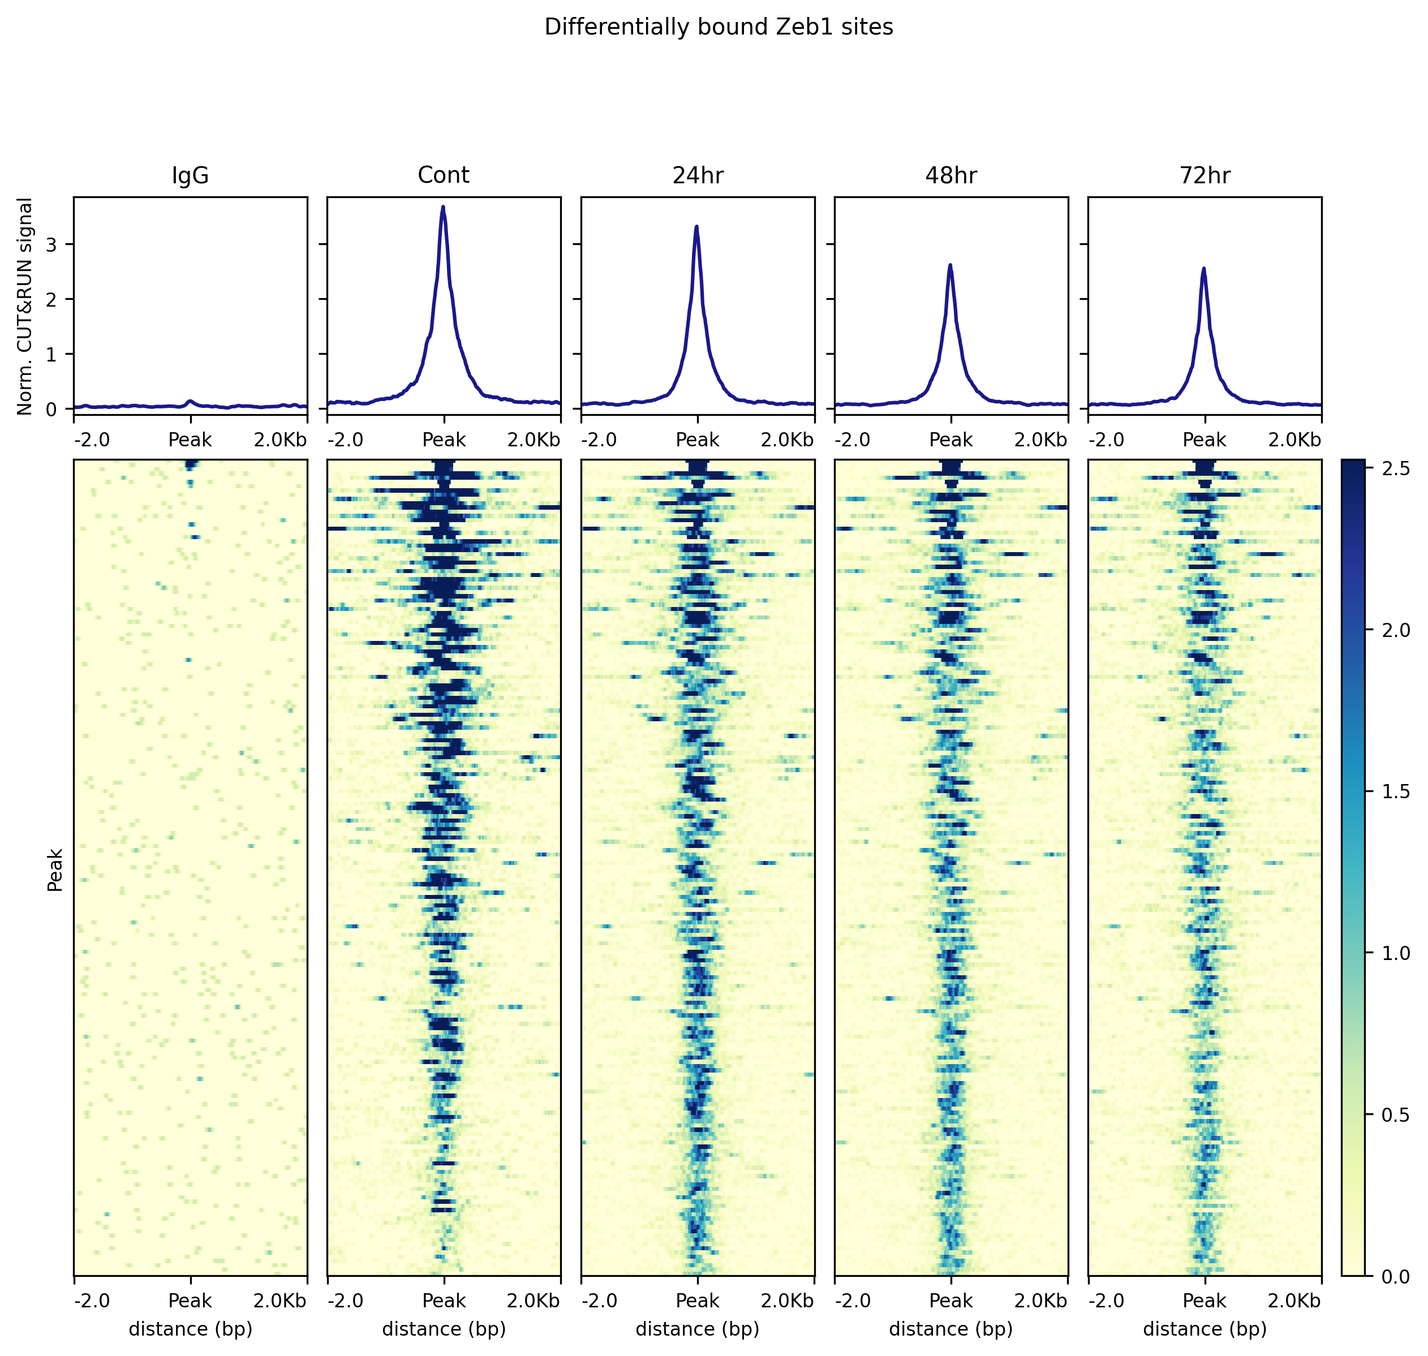
Zeb1 CUT&RUN – PB3, mm10 – Differentially bound peaks
Differentially bound peak set (n = 193) generated by merging all statistically significant differential peaks from analysis of control vs each tx-condition (24/48/72hr)

